Slide 1



OOP - Advanced
Polymorphism, Interfaces, Abstract Classes
SoftUni Team
Technical Trainers
Software University
http://softuni.bg

Slide 2


Table of Contents
Fundamental Principles of OOP
Polymorphism
Method override
Interfaces
Abstract Classes

Slide 3
Questions
sli.do #PHPFUND

Slide 4
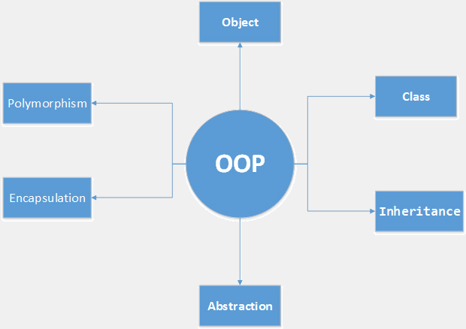
Fundamental Principles of OOP
Notes:
(c) 2006 National Academy for Software Development - http://academy.devbg.org*
4##

Slide 5
Fundamental Principles of OOP
Abstraction
Hide complexity
Encapsulation
Hide internal data
Inheritance
Inherit members from parent class
Polymorphism
Different functionality while sharing a common interface

Slide 6

Polymorphism

Slide 7
Polymorphism
Polymorphism is the ability to take on many forms
A child class may override (change) some of the parent's methods
The beauty of polymorphism is that the code working with the different classes does not need to know which class it is using since they are all used the same way
In the programming world, polymorphism is used to make applications more modular and extensible

Slide 8
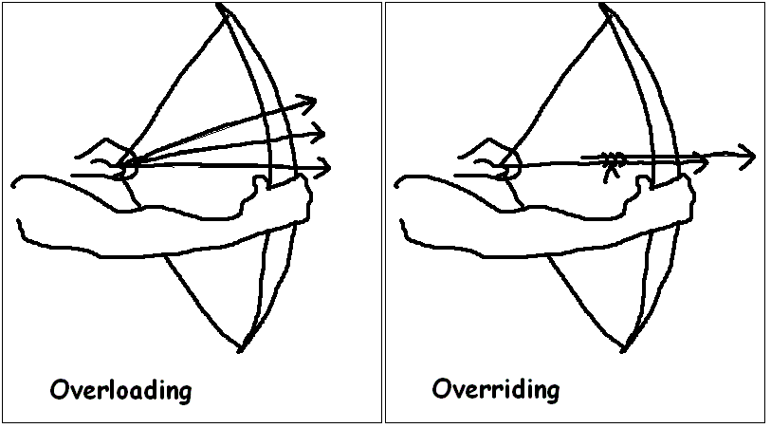
Override Methods
Notes:
The ability of a subclass to override a method allows a class to inherit from a superclass whose behavior is “close enough” and then to modify behavior as needed.

Slide 9
Overriding Methods - Rules
The argument list should be exactly the same
class Base {
public function printItem($string) {
echo 'Foo: ' . $string . PHP_EOL;
}
}
class Child extends Base {
public function printItem($string) {
echo 'Bar: ' . $string . PHP_EOL;
}
}

Slide 10
Overriding Methods – Rules (2)
The access level should be less restrictive or equal
class Base {
protected function printItem($string) {
echo 'Foo: ' . $string . PHP_EOL;
}
}
class Child extends Base {
public function printItem($string) {
echo 'Bar: ' . $string . PHP_EOL;
}
}

Slide 11
Overriding Methods – Rules (3)
A method declared final cannot be overridden
class Base {
final public function printItem($string) {
echo 'Foo: ' . $string . PHP_EOL;
}
}
class Child extends Base {
public function printItem($string) {
echo 'Bar: ' . $string . PHP_EOL;
}
} // Cannot override final method Base::printItem()

Slide 12
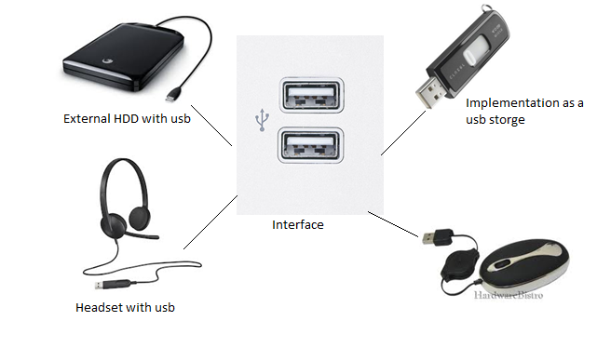
Interfaces

Slide 13
Interfaces
An integral part of polymorphism is the common interface.
Defining an interface is easy
Attach it to a class using the implements keyword
interface MyInterface {
// methods
}
class MyClass implements MyInterface {
// methods
}
Notes:
But they can be subclassed.

Slide 14
Interfaces Example
Methods can be defined in the interface just like in a class, except without the body
All methods defined here will need to be included in any implementing classes exactly as described
All methods declared in an interface must be public
interface MyInterface {
public function doThis();
public function doThat();
public function setName($name);
}
Notes:
But they can be subclassed.

Slide 15
Interfaces Valid Example
class MyClass implements MyInterface {
protected $name;
public function doThis() {
// code that does this
}
public function doThat() {
// code that does that
}
public function setName($name) {
$this->name = $name;
}
}
All methods included correctly

Slide 16
Interfaces Invalid Example
class MyClass implements MyInterface {
// missing doThis()!
private function doThat() {
// this should be public!
}
public function setName() {
// missing the name argument!
}
}
All methods not included correctly

Slide 17
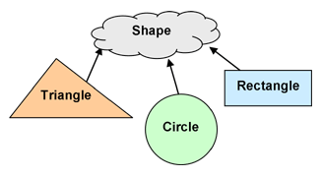
Abstract Classes

Slide 18
Abstract Classes
An abstract class is a mix between an interface and a class
It can define functionality as well as interface (in the form of abstract methods)
Classes extending an abstract class must implement all of the abstract methods defined in the abstract class.
abstract class MyAbstract {
// methods
}
Notes:
But they can be subclassed.

Slide 19
Extending Abstract Class
Abstract classes cannot be instantiated
Extending an abstract class is the same as with regular one
abstract class MyAbstract {
// methods
}
$abstract = new MyAbstract();
// Uncaught Error: Cannot instantiate abstract class
class MyClass extends MyAbstract {
// methods
}

Slide 20
Methods in Abstract Class
Regular methods can be defined in an abstract class
Abstract methods, using the abstract keyword
abstract class MyAbstract {
public $name;
public function doThis() {
// do this
}
abstract public function doThat();
abstract public function setName($name);
}

Slide 21

Concrete Example

Slide 22
Identify the Problem
Imagine that you have an Article class that is responsible for managing articles on your website
class Article {
public $title;
public $author;
public $date;
public $category;

Slide 23
Identify the Problem (2)
public function __construct($title, $author, $date, $category = 0) {
$this->title = $title;
$this->author = $author;
$this->date = $date;
$this->category = $category;
}
}

Slide 24
Identify the Problem (3)
Now you want to add a method to output the information into different formats, such as XML and JSON
You might be tempted to do something like this
class Article {
public function write($type) {
$ret = '';
switch($type) {
case 'XML':
$ret = '<article>';
$ret .= '<title>'.$this->title.'</title>';
Using switch to determine type is ugly, do not do this

Slide 25
Identify the Problem (4)
$ret .= '<author>'.$this->author.'</author>';
$ret .= '<date>'.$this->date.'</date>';
$ret .= '<category>'.$this->category.'</category>';
$ret .= '</article>';
break;
case 'JSON':
$array = ['article' => $this];
$ret = json_encode($array);
break;
}
return $ret;
}
}

Slide 26
What is the Problem with This Solution?
This is kind of an ugly solution, but it works - for now
Ask yourself what happens in the future, though, when we want to add more formats?
You can keep editing the class, adding more and more cases, but now you're only diluting your class
One important principle of OOP is that a class should do one thing, and it should do it well

Slide 27
Solution: Define Your Interface
Let's define a public write() method that accepts an Article object as an argument
Any classes implementing the Writer interface will be sure to have this method
interface Writer {
public function write(Article $obj);
}

Slide 28
Solution: Create Your Implementation
class newXMLWriter implements Writer {
public function write(Article $obj) {
$ret = '<article>';
$ret .= '<title>'.$obj->title.'</title>';
$ret .= '<author>'.$obj->author.'</author>';
$ret .= '<date>' . $obj->date . '</date>';
$ret .= '<category>'.$obj->category.'</category>';
$ret .= '</article>';
return $ret;
}
}
Our newXMLWriter using Writer Interface

Slide 29
Solution: Create Your Implementation (2)
Now here is our JSONWriter class
All of our code specific to each format is now contained within individual classes
class JSONWriter implements Writer {
public function write(Article $obj) {
$array = ['article' => $obj];
return json_encode($array);
}
}

Slide 30
Solution: Use the implementation
With our new classes defined, it is time to revisit our Article class
Replace our write method with the new one
class Article {
//...
public function write(Writer $writer) {
return $writer->write($this);
}
}

Slide 31
Solution: Obtaining a Writer
Create a factory class to grab request data and create an object
A method called without an instance of the class
class Factory {
public static function getWriter($name) {
$class = $name . 'Writer';
if (class_exists($class)) {
return new $class();
}
throw new Exception('Unsupported format');
}
}

Slide 32
Put It All Together
$article = new Article('Polymorphism', 'Steve', time(), 0);
try {
$writer = Factory::getWriter('JSON');
} catch (Exception $e) {
$writer = new newXMLWriter();
}
echo $article->write($writer);

Slide 33
Upgrade to Namespaces
Live Exercises in Class

Slide 34

Summary
Polymorphism
Different functionality while sharing a common interface
Abstract Classes and Methods
Interfaces

Slide 35








OOP Advanced
https://softuni.bg/courses/php-basics/

Slide 36
License
This course (slides, examples, demos, videos, homework, etc.) is licensed under the "Creative Commons Attribution-NonCommercial-ShareAlike 4.0 International" license
Attribution: this work may contain portions from
"PHP Manual" by The PHP Group under CC-BY license
"PHP and MySQL Web Development" course by Telerik Academy under CC-BY-NC-SA license

Slide 37





Free Trainings @ Software University
Software University Foundation – softuni.org
Software University – High-Quality Education, Profession and Job for Software Developers
softuni.bg
Software University @ Facebook
facebook.com/SoftwareUniversity
Software University @ YouTube
youtube.com/SoftwareUniversity
Software University Forums – forum.softuni.bg

